Slide 1
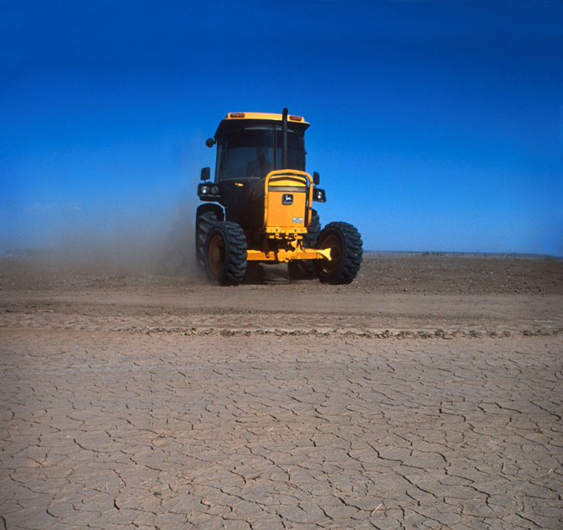

Drought risk assessment Agriculture SmartResilience December 2024

Slide 2
Summary
There is no universally applicable definition of drought - the use of drought indices introduces a mis-match between the measure and the impacts.
Regional drought – follow and liaise with the relevant national hydrometeorological agency. They will have tuned their indices to the specific locale. Agriculture is always a top priority.
Global drought – recommend using satellite data. NDVI is a mature product and a good place to start.
Climate change – recommend SPEI. Need to be aware of correlation risk and sensitivity to method used to estimate PET.
Drought vs aridity - be aware of the distinction between changes in drought frequency and severity (temporary) c.f. desertification (permanent).

Slide 3
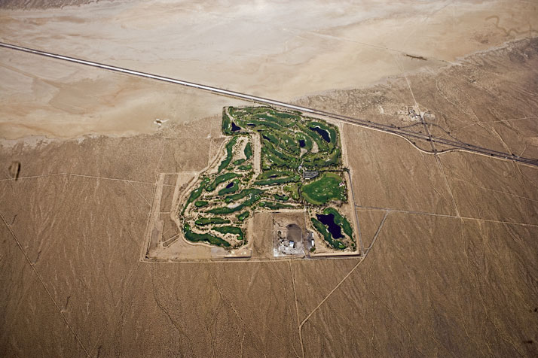
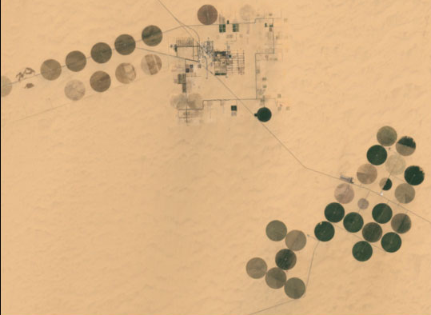
Managing the risk
Drought is an avoidable risk. However, it is usually uneconomic to do so.
Risk reduction:
Operational change (e.g. different crop)
Drought preparedness (e.g. reservoir)
Adaptive operation (e.g. irrigation)
Risk transfer:
Insurance (crop insurance)
Securitisation (cat bonds)
Notes:
Golf course in Las Vegas. Boom irrigation in Morocco.

Slide 4
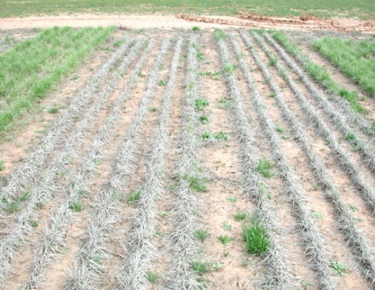
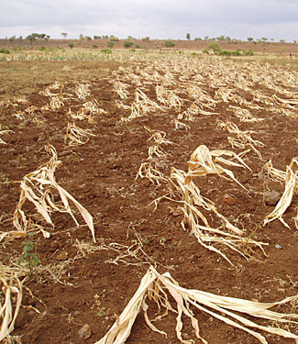
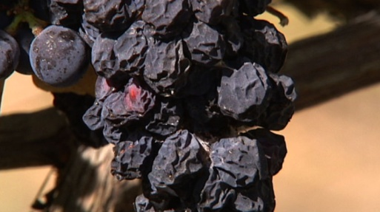
Economic impacts: Agricultural
Agricultural:
Annual and perennial crop losses
Damage to crop quality
Increased irrigation costs
Cost of new or supplemental water resource development (wells, dams, pipelines)
Wildlife damage to crops
Reduced productivity of cropland (wind erosion, long-term loss of organic matter, etc.)

Slide 5
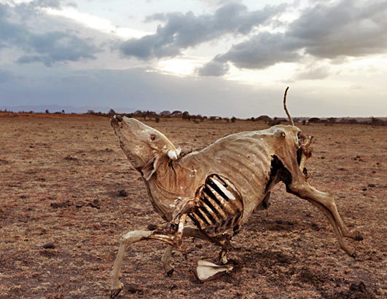
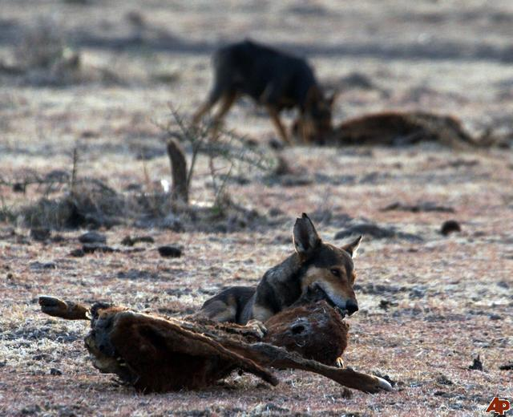
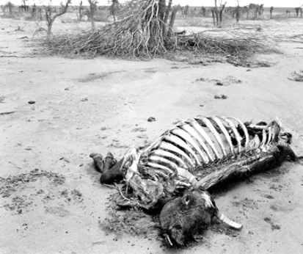
Economic impacts: Livestock
Livestock:
High livestock mortality rates
Increased feed costs
Decreased stock weights
Reduced milk production
Forced reduction of foundation stock
Disruption of reproduction cycles (delayed breeding, more miscarriages)
Increased predation
Range fires

Slide 6
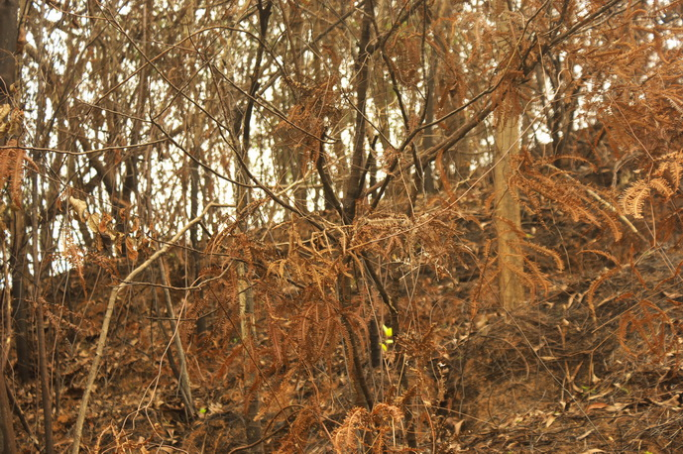
Economic impacts
Timber production:
Wildland fires
Tree disease
Insect infestation
Impaired productivity of forest land
Direct loss of trees, especially young ones
Fisheries:
Damage to fish habitat
Loss of fish and other aquatic organisms due to decreased flows

Slide 7
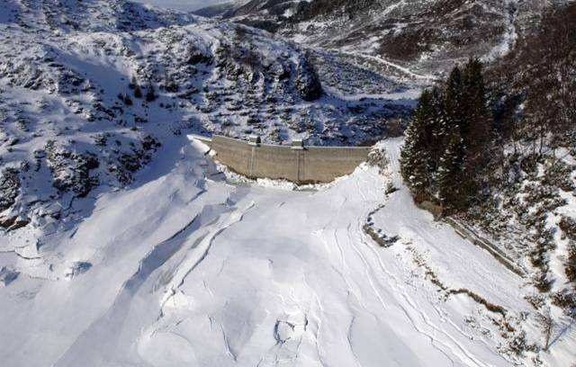
Economic impacts: Energy
Energy-related effects
Increased energy demand and reduced supply because of drought-related power curtailments
Costs to energy industry and consumers associated with substituting more expensive fuels (oil) for hydroelectric power

Slide 8
Economic impacts: Public supply
Water Suppliers
Revenue shortfalls and/or windfall profits
Cost of water transport or transfer
Cost of new or supplemental water resource development

Slide 9
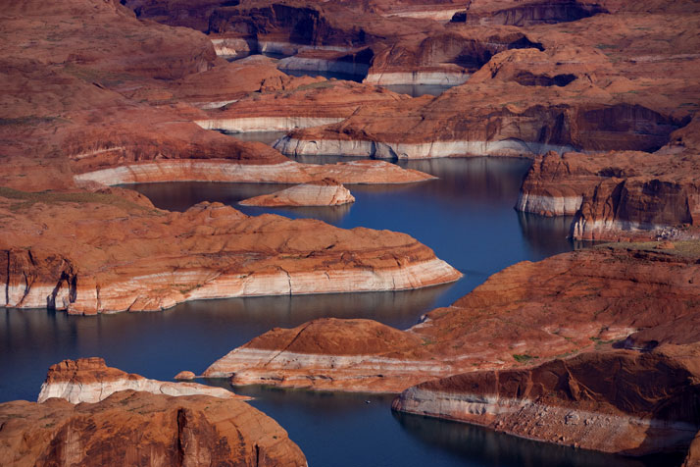
Notes:
Lake Mead (the impounded Colorado River) at Hoover Dam, Arizona-Nevada, U.S. The light-coloured band of rock above the shoreline shows the decreased water level of the reservoir in the early 21st century.

Slide 10
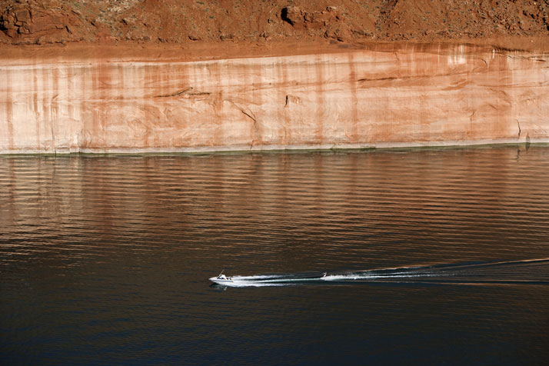
Notes:
Lake Mead (the impounded Colorado River) at Hoover Dam, Arizona-Nevada, U.S. The light-coloured band of rock above the shoreline shows the decreased water level of the reservoir in the early 21st century.

Slide 11
Not all bad news...
Tourism, transport and construction: Businesses that function better in dry weather.
Electric utilities: e.g. 2003 electric utilities record-high power sales from June to August as people use air conditioning for relief from the heat wave associated with the drought.
Non-hydroelectric power producers: Hydroelectric power companies, suffering the effects of low river flows, must bolster their supplies by buying energy from other sources.
Water-producing companies: “Water technology” companies, such as those providing well drilling, weather modification, and chemicals for suppressing evaporation.

Slide 12
Difficult to transfer the risks
The inconvenient nature of drought:
Large spatial correlation scale
Trans-national impacts
Repeating
Long lasting
Persists for months to years
Prolonged claims history
E.g. subsidence claims may lag the event by up to 1-2 years.
Difficult to define
No universally accepted definition
Large correlation risks (mismatch between drought indicator and impacts)

Slide 13
Drought definition
OED:
1. The condition or quality of being dry; dryness, aridity, lack of moisture.
2. Dryness of the weather or climate; lack of rain.

Slide 14
Drought definition
OED:
1. The condition or quality of being dry; dryness, aridity, lack of moisture.
2. Dryness of the weather or climate; lack of rain.
WMO (1992, Nº 182):
1.Prolonged absence or marked deficiency of precipitation.
2. Period of abnormally dry weather sufficiently prolonged for the lack of precipitation to cause a serious hydrological imbalance.

Slide 15
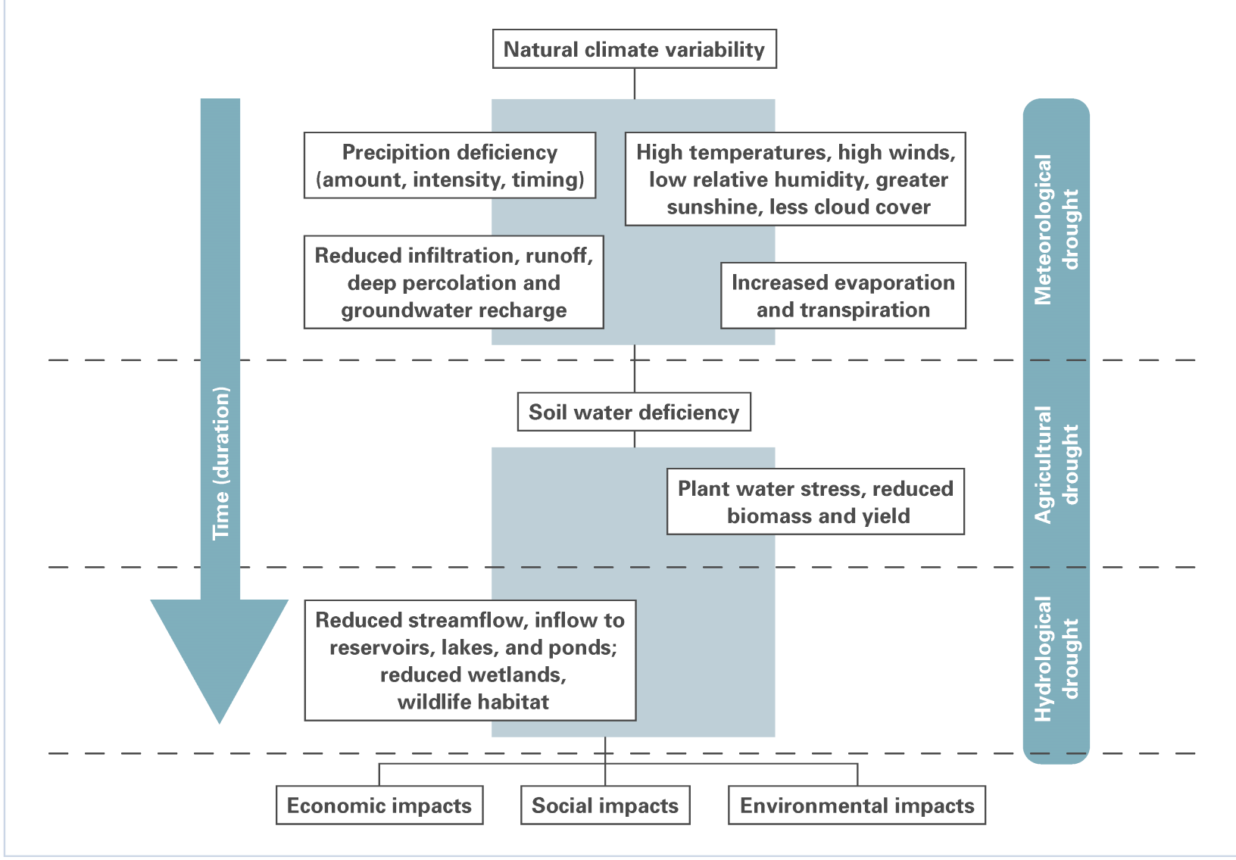

Slide 16
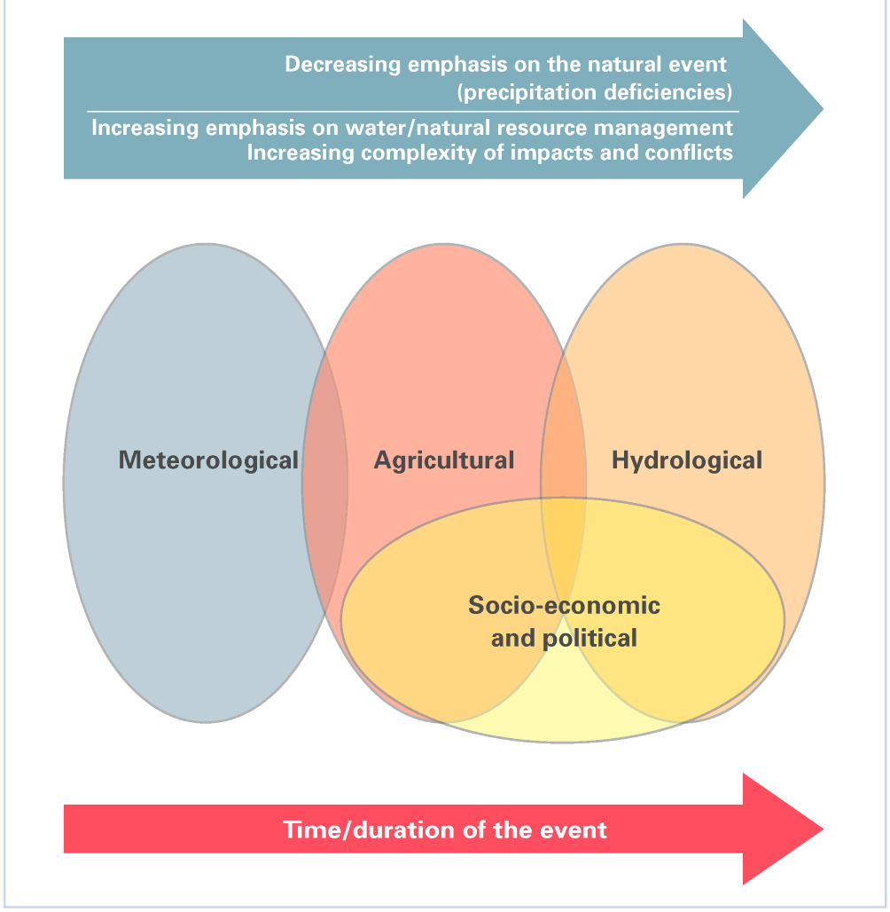

Slide 17
Drought indices
Drought is typically quantified via an index which formalises the general qualitative definition that drought is ‘a deficit of water relative to normal conditions’.
A general drought index should:
Identify main characteristics of droughts:
- onset, end, severity, spatial extent
Map drought events
Compare events in space and time
Provide a basis for drought management:
- define thresholds, triggers, alarm levels

Slide 18
57 varieties of drought index
NMDC – Normalized Multi-Band Drought Index
VCADI – Vegetation Condition Albedo Drought Index
PDI – Perpendicular Drought Index
MPDI – Modified Perpendicular Drought Index
RDRI – Remote Sensing Drought Risk Index
VegDRI – Vegetation Drought Response Index
ADI – Aggregate Drought Index
SMDI – Soil Moisture Deficit Index
ETDI – Evapotranspiration Deficit Index
RDI – Reconnaissance Drought Index
RSDI – Regional Streamflow Deficiency Index
SDI – Sperling Drought Index
NDVI – Normalized Difference Vegetation Index
Notes:
57 – varities of drought index - Thanks to Stefan Niemeyer at EC JRC

Slide 19
57 varieties of drought index
VCI – Vegetation Condition Index
NDVIA – Anomaly of Normalized Difference Vegetation Index
SVI – Standardized Vegetation Index
NDWI – Normalized Difference Water Index
NDII – Normalized Difference Infrared Index
LWCI – Leaf Water Content Index
DTx – agricultural drought index
DFI – Drought Frequency Index
TCI – Temperature Condition Index
VHI – Vegetation Health Index
SRWI – Simple Ratio Water Index
GVWI – Global Vegetation Water moisture Index
KI – Kincer’s Index

Slide 20
57 varieties of drought index
WI – Water Index
%N – percentage of normal
DECILES – deciles
RAI – Rainfall Anomaly Index
BMDI – Bhalme and Mooly Drought Index
SAI – Standardized Anomaly Index
DSI – Drought Severity Index
PAI – Palfai Aridity Index
EDI – Effective Drought Index
Q90 – low flow index
BFI – Base Flow Index
SWSI – Surface Water Supply Index
PHDI – Palmer Hydrological Drought Index

Slide 21
57 varieties of drought index
RDI – Reclamation Drought Index
CMI – Crop Moisture Index
SMDI – Soil Moisture Drought Index
CSDI – Crop Specific Drought Index
CDI – Corn Drought Index
SCI – Soybean Drought Index
KBDI – Keetch-Byram Drought Index
NBR – Normalized Burn Ratio
PDSI – Palmer Drought Severity Index
PMDI – Palmer Modified Drought Index
Z-Index – Palmer Z-Index
MI – Munger’s Index
MI – Marcovitch’s Index

Slide 22
57 varieties of drought index
BI – Blumenstock’s Index
API – Antecedent Precipitation Index
MAI – Moisture Adequacy Index
DMII – Drought Monitor Integrated Index
CZI – China Z-Index

Slide 23
Is drought definable?
In practical terms probably not!
See ‘The impracticality of a universal drought definition’ (Lloyd-Hughes 2013)
However, to be pragmatic, we should pick the index which best matches our impact of interest (minimise the correlation risk).
Local expertise is critical here – recommend reaching out to local hydrometeorological agencies – supporting agriculture will be one of their key functions.

Slide 24
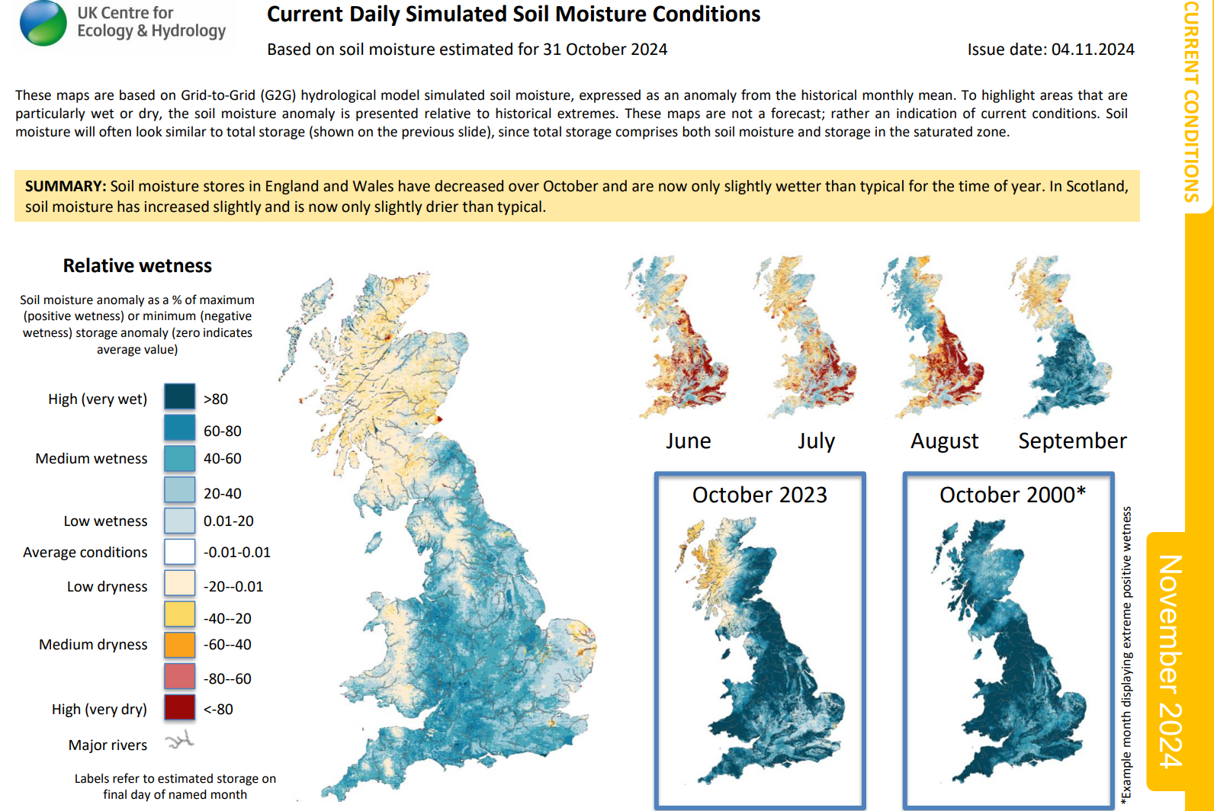
Day-to-day monitoring
Local:
National hydro/met agency e.g.
UK Centre for Ecology and Hydrology

Slide 25
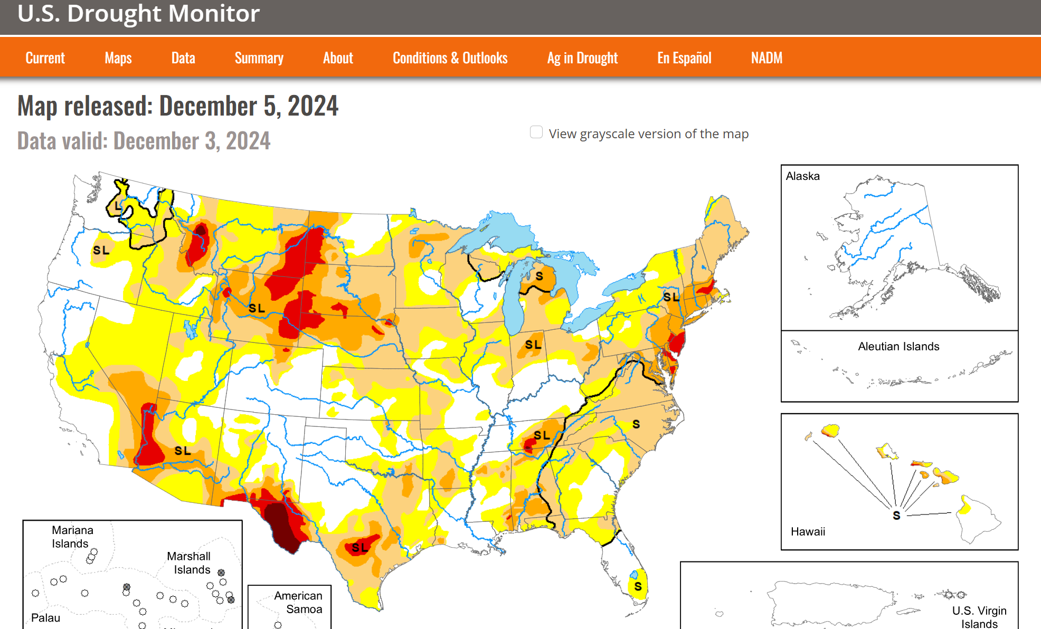
Day-to-day monitoring
Local:
National hydro/met agency e.g.
US, North American Drought Monitor
Notes:
https://droughtmonitor.unl.edu/

Slide 26
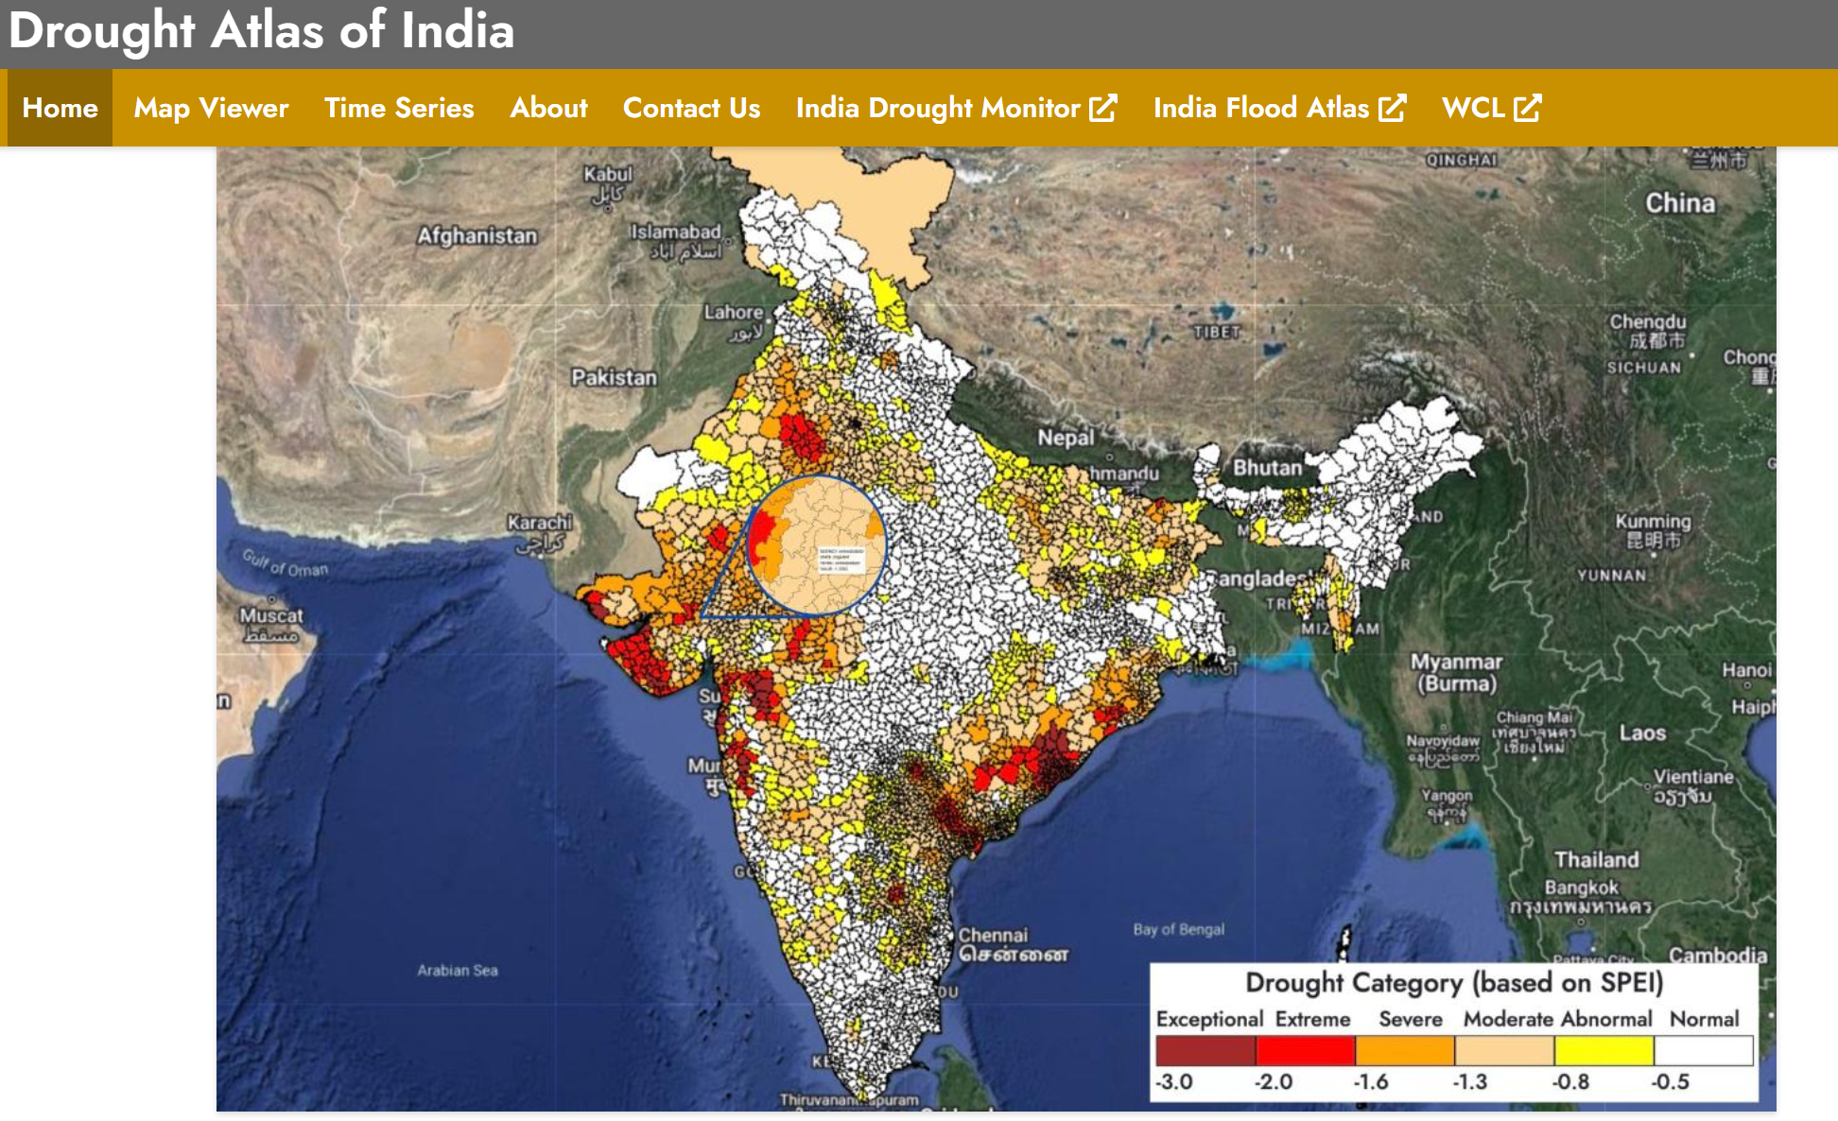
Day-to-day monitoring
Local:
National hydro/met agency e.g.
Indian Drought Atlas/Monitor
Notes:
https://indiadroughtatlas.in/

Slide 27
Day-to-day monitoring
Global:
Regional monitors lack consistency and do not provide spatial coverage.
Satellite observations can help:
Spectral measurements
Rainfall estimates
Gravitational measurements
Soil moisture retreivals (experimental, only first few cm of soil).

Slide 28
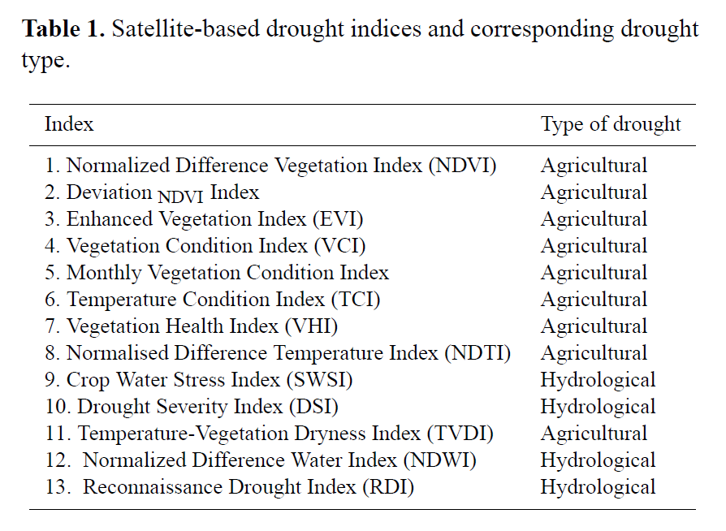
Spectral Satellite Drought Indices
Again, there are many…
‘Best’ index will depend on use case.
The NDVI is readily available and well understood.
Historic archives available which may help in risk assessment.
[Source: Dalezios et al., 2012]

Slide 29
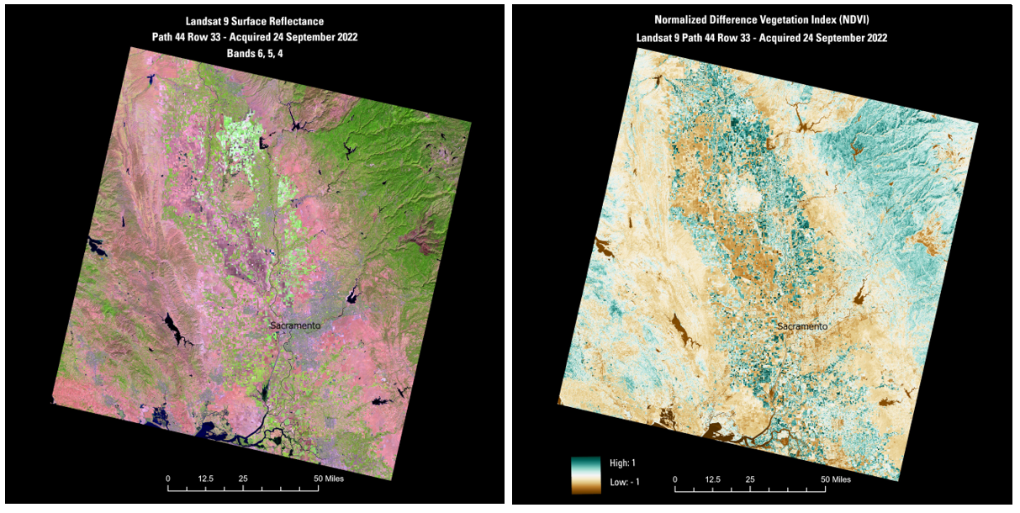
NDVI
Normalized Difference Vegetation Index (NDVI) is used to quantify vegetation greenness and is useful in understanding vegetation density and assessing changes in plant health.
Notes:
Detailed description: https://www.usgs.gov/landsat-missions/landsat-surface-reflectance-derived-spectral-indices

Slide 30
Climate change projections
In situ and satellite observations are unavailable for the future. This motivates the use of meteorological indices as a proxy.
Beware of the increased correlation risk!
Again, there are many indices…
Two main candidates:
Standardized Precipitation Index (SPI)
Standardized precipitation evapotranspiration index (SPEI):

Slide 31
SPI
Standardized precipitation index (SPI):
The n-month accumulation at a given location at particular time of year is transformed (in terms of probability) into a standard normal variate.
Advantages
Robust, simple and extensible.
Precipitation is the dominant driver (see e.g. Oladipo, 1985).
Disadvantages
Only considers precipitation. Takes no account of evapotranspirative losses.
No obvious way choose the accumulation period to match the impact of interest.

Slide 32
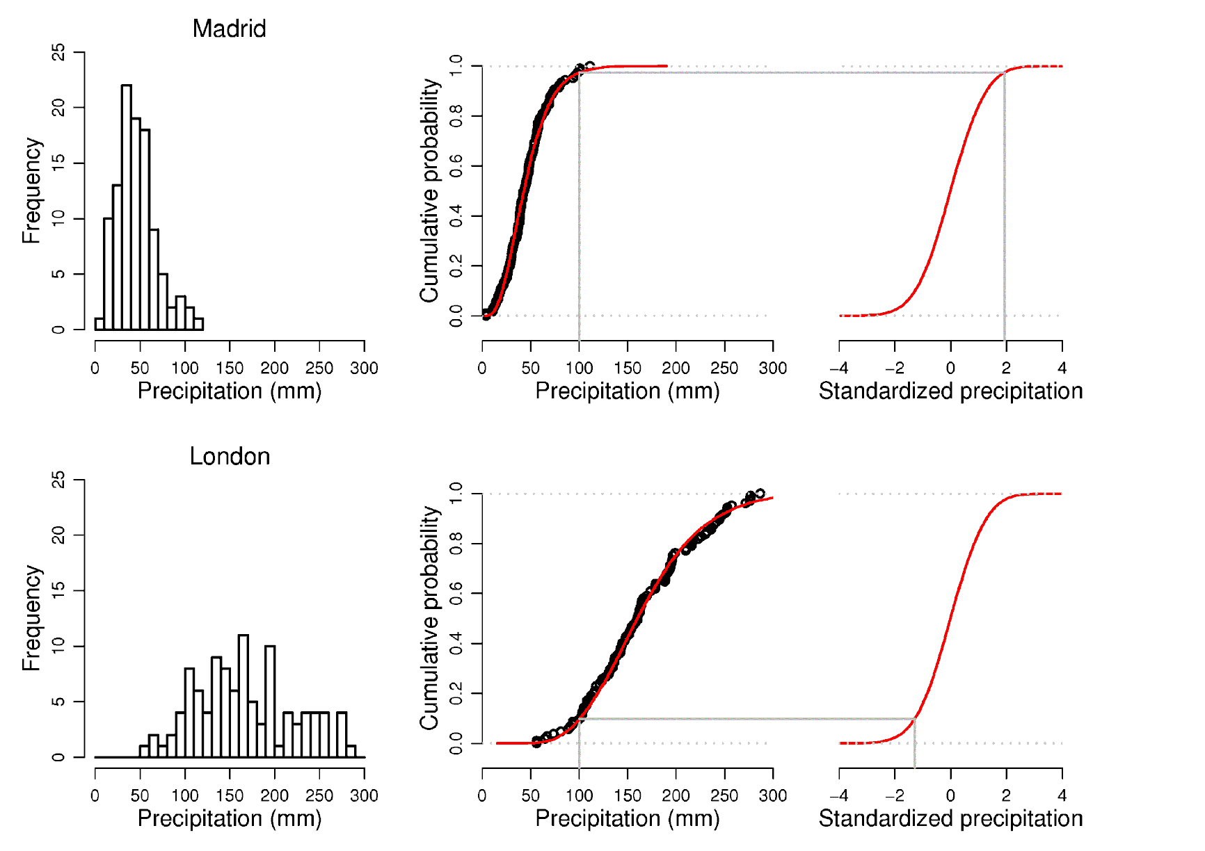
Madrid
3-month summer accumulation (JJA)
London

Slide 33
SPEI
Standardized precipitation evapotranspiration index(SPEI):
Extends the SPI to account for potential evapotranspiration (PET).
Standardises Precipitation – PET.
Introduces a new problem – PET is notoriously hard to estimate.
Sensitive to global warming (via PET estimate).
Climate datasets are readily available e.g. JRC
Notes:
Vicente-Serrano S.M.; Santiago Beguería; Juan I. López-Moreno (2010). "A Multiscalar Drought Index Sensitive to Global Warming: The Standardized Precipitation Evapotranspiration Index". Journal of Climate. 23 (7): 1696–1718. Bibcode:2010JCli...23.1696V. doi:10.1175/2009JCLI2909.1. S2CID 3826822.
Python code here: https://pypi.org/project/spei/

Slide 34
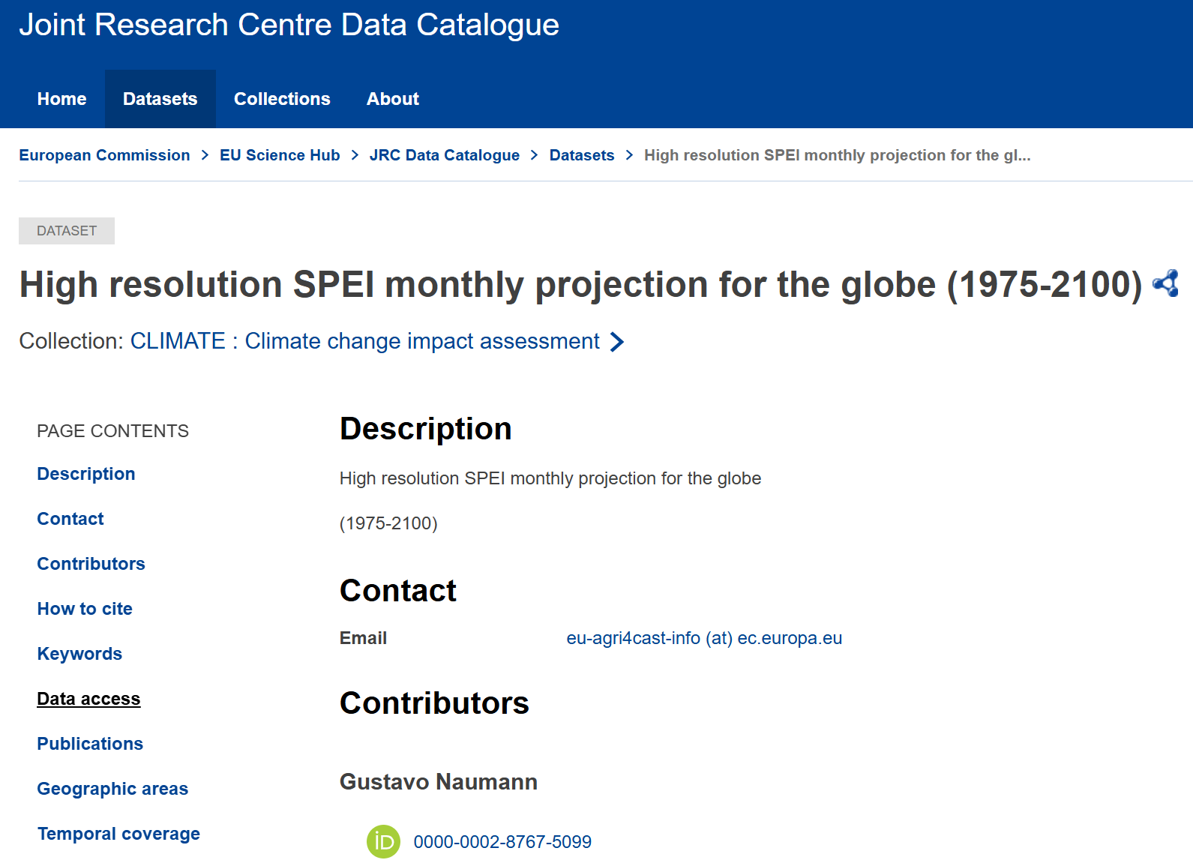
SPEI
Notes:
https://data.jrc.ec.europa.eu/dataset/jrc-climate-spei-drought-helix-ec-earth-1975-2100

Slide 35
Climate change: Aridity versus Drought
Unlike droughts (however defined) increased aridity represents a permanent transformation.
Droughts end, aridity changes persist.
When an area's climate becomes drier the ability to return to previous conditions can be lost.
Does not need to be as extreme as desertification to make agriculture difficult:
Dry sub-humid lands (well suited for agriculture e.g. cotton and wheat)
Semi-arid lands
Arid lands
Hyper-arid lands (no vegetation)

Slide 36
Conclusions
There is no universally applicable definition of drought - the use of drought indices introduces a mis-match between the measure and the impacts.
Regional drought – follow and liaise with the relevant national hydrometeorological agency. They will have tuned their indices to the specific locale. Agriculture is always a top priority.
Global drought – recommend using satellite data. NDVI is a mature product and a good place to start.
Climate change – recommend SPEI. Need to be aware of correlation risk and sensitivity to method used to estimate PET.
Drought vs aridity - be aware of the distinction between changes in drought frequency and severity (temporary) c.f. desertification (permanent).

Slide 37
Next steps
Critical evaluation of the ability of climate models to represent drought.
Investigation of the relationships between SPEI values and agricultural impacts.

